Slide 1


Department of Artificial Intelligence and Data Science
191AI67A – Mini Project
FARMER TO CONSUMER USER INTERFACE DESIGN(UI)
Team Members:
V NANDHANA - 113120UG08026
R VALLI - 113120UG08049
M SUBIKSHA - 113120UG08044
K SAMHITH REDDY - 113120UG08019
Guided by,
Mrs.G . Porkodi, M.E.,
Asst.Professor,
Dept of AIDS.
Batch No: xx
Date : 30.04.2023

Slide 2
Objective
To provide farmers with a direct channel to sell their fresh products to consumers, while enabling consumers to conveniently order and receive high-quality, locally-sourced food products directly from the farmers, thereby promoting sustainable agriculture and supporting local communities.mainly these interface created by using figma tool.

Slide 3
Abstract
  This ordering application aims to bridge the gap between farmers and consumers by providing a platform where farmers can directly sell their fresh products to consumers
  The application will enable farmers to create profiles, list their available products, and set prices
  Consumers will be able to search for products, place orders, and make payments through the app
  The app will also provide a rating system to help consumers make informed choices about the quality of the products and the reliability of the farmers.
  By connecting farmers and consumers directly, the application promotes sustainable agriculture and supports local communities.
  After consumer adding products to cart .it shows an mode of payments after choosing an option the farmer accept request .finally the product is delivered to consumer

Slide 4
Existing System
farmer-to-consumer ordering typically involves farmers selling their produce through middlemen, such as wholesalers and retailers. These middlemen often take a significant cut of the profits, leaving farmers with little control over the prices and quality of their products.
However, there are now several online platforms that enable farmers to sell directly to consumers. One example is the website Farmigo, which allows consumers to order fresh produce, dairy products, and meat directly from local farmers.
Farmers can create profiles and list their available products, which are then displayed on the website. Consumers can browse products, place orders, and make payments online. The orders are then delivered to local pickup locations, where consumers can collect their produce at their convenience.

Slide 5
Disadvantages
While the farmer-to-consumer ordering design offers many advantages, there are also some potential disadvantages that should be considered. Here are some of them
Dependence on technology: Farmers who are not familiar with using digital platforms may find it challenging to list their products and manage orders through online ordering systems.
Limited market access: The farmer-to-consumer ordering design typically targets a local customer base. This may limit the farmers' reach to customers outside of their area.
Delivery logistics: Farmers may need to invest in transportation and delivery logistics to fulfill orders made through the online platform. This can be especially challenging for small-scale farmers who have limited resources.
Competition: The farmer-to-consumer ordering design is becoming increasingly popular, which means that farmers may face increased competition from other producers offering similar products.
Payment processing fees: Many online platforms charge fees for payment processing, which can eat into farmers' profits.
Quality control: Farmers may need to invest in packaging and refrigeration to ensure that their products arrive at the customer's doorstep in good condition. They will also need to be responsive to customer feedback to maintain their reputation and ensure repeat business.

Slide 6
Literature Survey
Basically the above design farmer to consumer its my own idea. Where; the famer to consumer odering design is becoming incresingly popular as consumers are becoming more consious about the source of their food and the impact it has on the environment
Several studies have highlighted the potential benefits of this model, including reduced transportation costs, increased profitability for farmers, and fresher, healthier produce for consumers
farmer-to-consumer ordering design has significant potential benefits, but also poses challenges that must be addressed to ensure its success. Future research should focus on developing solutions to the challenges faced by small-scale farmers, improving logistics and delivery options, and identifying ways to scale up the model to reach a wider audience.

Slide 7
Proposed system
Farmer registration: Farmers can register on the application and provide details about their farm, crops, and other relevant information.
Product listing: Farmers can list the products they have available for sale, along with their prices and quantity.
Consumer registration: Consumers can register on the application and provide their details such as name, address, and contact information.
Product search: Consumers can search for the products they want to buy based on category, location, and price range.
Order placement: Consumers can place orders for the products they want to buy and choose the delivery option (pickup or delivery).
Payment gateway: The application should have a secure payment gateway that supports various payment methods such as credit/debit cards, net banking, and digital wallets.
Delivery management: Farmers can manage the delivery of the products to consumers through the application and update the delivery status.
Feedback and rating: Consumers can provide feedback and ratings for the products they purchase and the overall buying experience.

Slide 8
Advantages
Increased profitability: By eliminating the intermediaries and selling directly to consumers, farmers can earn higher profits for their products.
Market expansion: The application provides access to a wider market for farmers beyond their local area, thereby expanding their customer base and increasing sales opportunities.
Reduced wastage: With direct sales to consumers, farmers can better estimate demand and reduce wastage by producing only what they can sell.
Improved communication: The application facilitates direct communication between farmers and consumers, allowing farmers to understand consumer needs and preferences better.
Brand building: Farmers can build their brand and reputation by providing high-quality products directly to consumers, leading to increased customer loyalty.

Slide 9
Comparison
CHARACTERISTICS | EXISTING SYSTEM | PROPOSED SYSTEM
ACCURACY | LOW | HIGH
PRIVACY | LOW | HIGH
EFFECTIVENESS | LOW | HIGH
COST | HIGH | LOW

Slide 10
Hardware Requirements
Operating System : Windows XP/Android/IOS
Processor : Intel Core 2 DUO / AMD Athlon 64 X2 5600+
Video card : NVIDIA Ge Force 7600 GT / ATI Radeon HD 2600 XT / Intel HD Graphics 3000
Memory : 1GB
Locator : Fix to vechical to track delivery man
Resolution : 1024*768 minimum display resolution

Slide 11
Software Requirements
Software Tool : Figma,Vscode
Operating System : Windows 10
Processors : Any Intel or AMD X86-64 processor
RAM : 2GB
Graphics Card : No Specific graphics card required

Slide 12
Implementation
Define the requirements:
Choose the technology stack
Design the application architecture:
Develop the application
Test the application
Deploy the application
Maintain and update the application:
Market the application

Slide 13
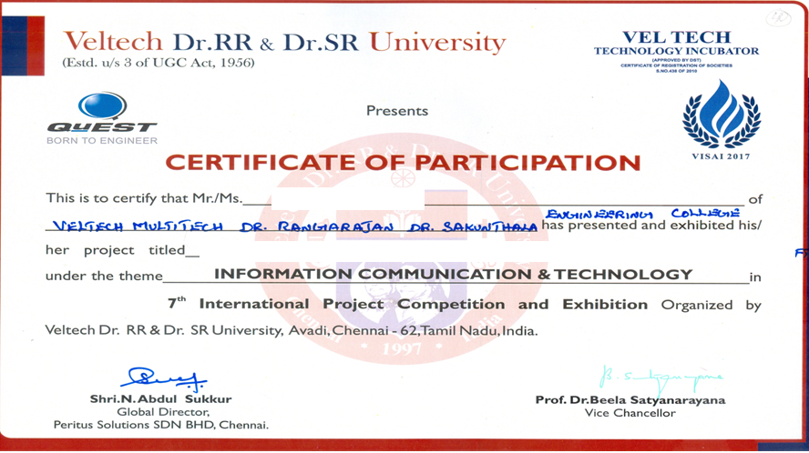

Participation Certificate

Slide 14
THANK YOU

